Slide 1
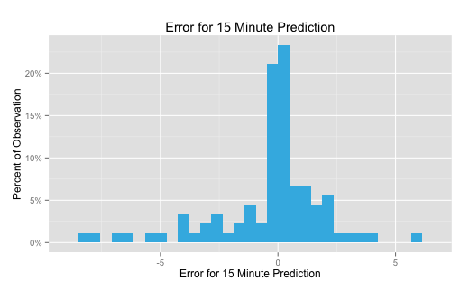
15 Minutes in Advance
54% of predictions within 1 bike of actual
82% within 3 bikes
93% within 5 bikes

Slide 2
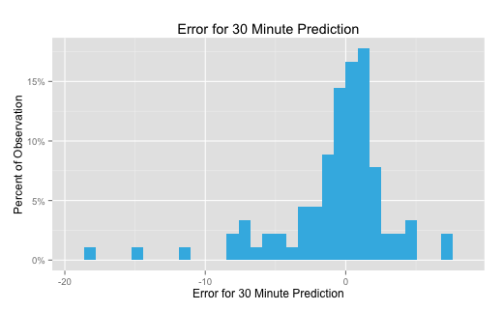
30 Minutes in Advance
40% of predictions within 1 bike of actual
73% within 3 bikes
84% within 5 bikes

Slide 3
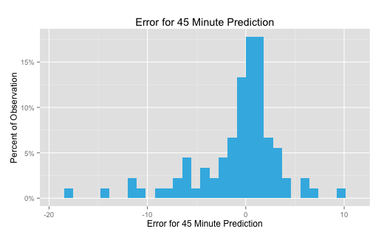
45 Minutes in Advance
38% of predictions within 1 bike of actual
69% within 3 bikes
80% within 5 bikes

Slide 4
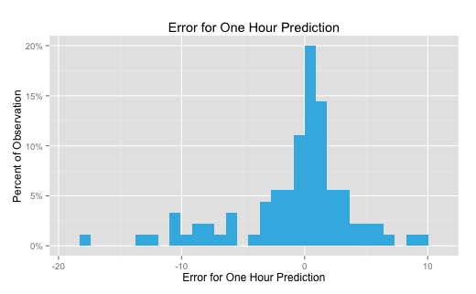
One Hour in Advance
33% of predictions within 1 bike of actual
66% within 3 bikes
77% within 5 bikes

Slide 5
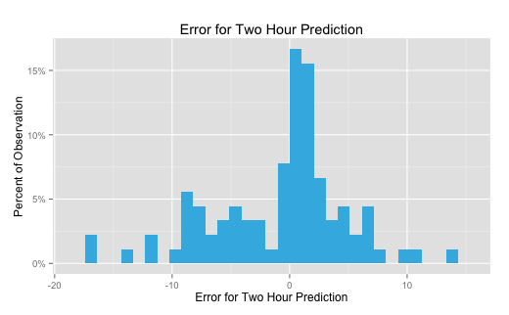
Two Hours in Advance
23% of predictions within 1 bike of actual
49% within 3 bikes
66% within 5 bikes

